Slide 1
Sponsorship Options
Sponsorship | Exhibitor | Gold Sponsor | Platinum Sponsor
Package price (excl. VAT) – for GSE Members | 5.900 € | 9.600 € | 15.000 €
Package price (excl. VAT) – for Non-GSE Members | 7.600 € | 12.400 € | 19.500 €
Keynote Slot On day 1 or 2 of the conference (30 minutes)
Possibility for a Hands-On Workshop on Wednesday
Conference Tickets for your Team/Employees 2x – without hotel accommodation
Conference Tickets for your End Customers 2x – without hotel accommodation
Professional Demo Booth (Monday – Wednesday) Incl. Back panel with company logo print, 1x screen, 1x source notebook with current MS Office Prof., 1x lead scanner, 1x roll container and 2x bar stools
Short Company Presentation During the guided tour in the exhibition area on Monday
Digital Contest / Prize Draw Attendees use their smartphones to explore the exhibition area, scanning QR codes at each exhibitor booth. Attendees who visited all booths participate at a prize draw.
Company Logo on Online Conference Brochure
Marketing on the Event Website Logo und Company Profile
Marketing on GSE Social Media Platforms Post on LinkedIn, Facebook and Twitter (X)
Exclusive Video Interview for Social Media Professionally recorded video interview during the conference – perfect for sharing on LinkedIn, your website, or other social media channels.
Only 3 packages available!
Choice of presentation day and slot is possible

Slide 2

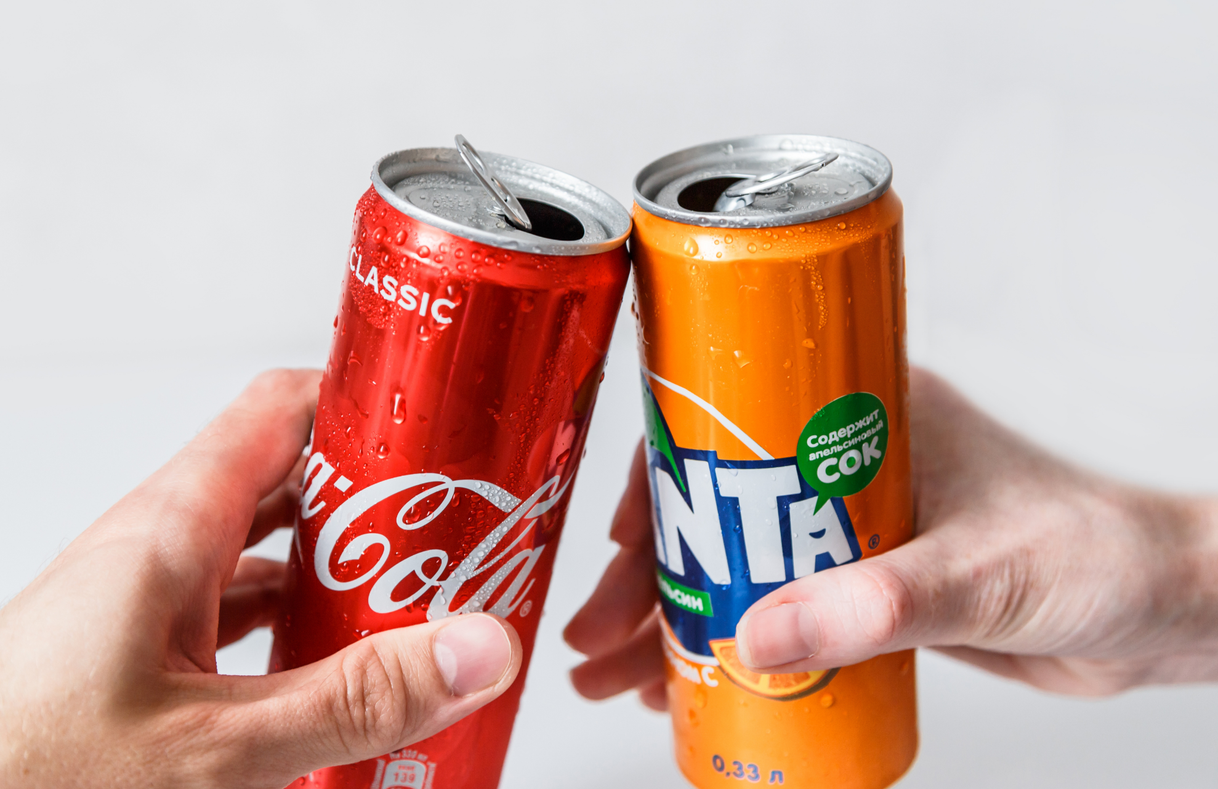

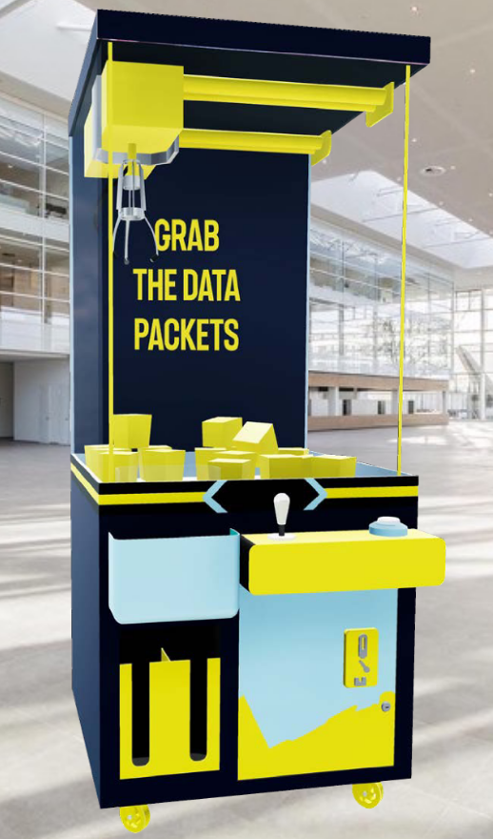

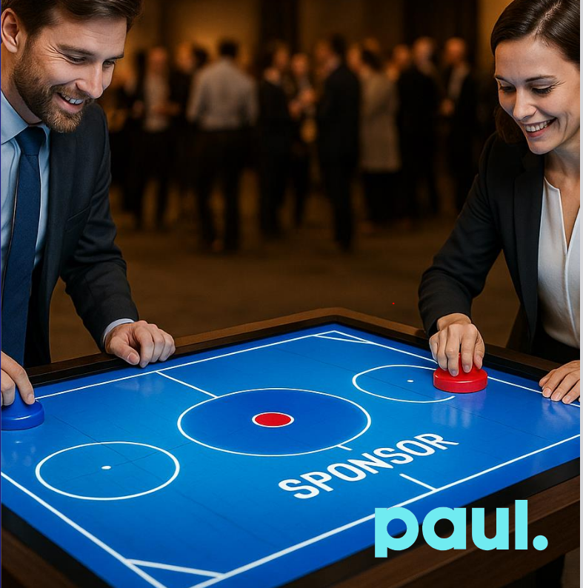


Add-On Sponsorship Options WITH a Sponsorship Package – first come, first served
Soft drinks-Table for all participants
Price (excl. VAT) – for GSE Members | 3.000 €
Price (excl. VAT) – for Non-GSE Members | 4.000 €
Claw Machine
Price (excl. VAT) – for GSE Members | 3.000 € *
Price (excl. VAT) – for Non-GSE Members | 4.000 € *
Treat your guests to refreshing soft drinks (e.g. Coke, Fanta, Lemonade) – not included in the conference package, but showcased with a personalized table sign featuring your company logo.
The claw machine grabs everyone’s attention – with flashing lights, thrilling action, and fantastic prizes.
Whether it’s cool giveaways or exclusive prizes: here, everyone becomes a treasure hunter! The fun of the game sparks conversation, increases dwell time, and creates excitement. *Price with branding (excluding graphics) and without prize items.
Digital Air Hockey Game
Price (excl. VAT) – for GSE Members | 4.000 €
Price (excl. VAT) – for Non-GSE Members | 5.000 €
Digital Badge for Conference Participation (issued by Credly by Pearson)
Price (excl. VAT) – for GSE Members | 6.000 €
Price (excl. VAT) – for Non-GSE Members | 7.000 €
The digital touchtable with air hockey game provides fast-paced duels, smiling faces, and captivated looks – right in the middle of the event action.
While visitors engage in exciting matches, sponsor branding is prominently visible on the playing field and closely linked to the player experience. Perfect for a modern, dynamic brand presence that not only stands out but also excites.
An interactive highlight that’s fun, connects people – and leaves a lasting impression of the sponsor.
Give participants a powerful way to showcase their learning success – and place your brand right at the heart of their professional recognition. The digital certificate, including your logo, can easily be shared on platforms like LinkedIn, reaching a wide audience of peers, professionals, and decision-makers. A lasting brand presence that reinforces your company’s commitment to innovation, education, and industry development.

Slide 3
Add-On Sponsorship Options WITHOUT a Sponsorship Package – first come, first served
Soft drinks-Table for all participants
Price (excl. VAT) – for GSE Members | 4.000 €
Price (excl. VAT) – for Non-GSE Members | 5.000 €
Claw Machine
Price (excl. VAT) – for GSE Members | 4.000 € *
Price (excl. VAT) – for Non-GSE Members | 5.000 € *
Treat your guests to refreshing soft drinks (e.g. Coke, Fanta, Lemonade) – not included in the conference package, but showcased with a personalized table sign featuring your company logo.
The claw machine grabs everyone’s attention – with flashing lights, thrilling action, and fantastic prizes.
Whether it’s cool giveaways or exclusive prizes: here, everyone becomes a treasure hunter! The fun of the game sparks conversation, increases dwell time, and creates excitement. *Price with branding (excluding graphics) and without prize items.
Digital Air Hockey Game
Price (excl. VAT) – for GSE Members | 5.000 €
Price (excl. VAT) – for Non-GSE Members | 6.000 €
Digital Badge for Conference Participation (issued by Credly by Pearson)
Price (excl. VAT) – for GSE Members | 7.000 €
Price (excl. VAT) – for Non-GSE Members | 8.000 €
The digital touchtable with air hockey game provides fast-paced duels, smiling faces, and captivated looks – right in the middle of the event action.
While visitors engage in exciting matches, sponsor branding is prominently visible on the playing field and closely linked to the player experience. Perfect for a modern, dynamic brand presence that not only stands out but also excites.
An interactive highlight that’s fun, connects people – and leaves a lasting impression of the sponsor.
Give participants a powerful way to showcase their learning success – and place your brand right at the heart of their professional recognition. The digital certificate, including your logo, can easily be shared on platforms like LinkedIn, reaching a wide audience of peers, professionals, and decision-makers. A lasting brand presence that reinforces your company’s commitment to innovation, education, and industry development.

Slide 4
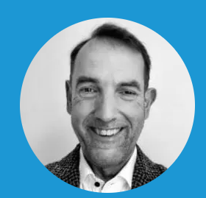

Ansprechpartner - Konferenzinhalt
GSE DACH Jahreskonferenz 2026
 | Dr. Michael Weiß GSE Region Manager Deutschland michael.weiss@gse.org +49 151 224 96664
Working Groups Event
 | Alexander L. Pawlik GSE Region Manager Österreich GSE Technical Coordinator Deutschland GSE Chairman European Enterprise Modernization for z/OS Working Group alexanderl.pawlik@huk-coburg.de +49 9561 96 61750

Slide 5
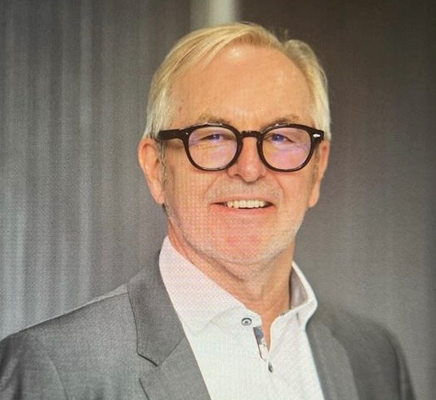
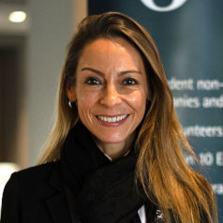
Konferenzorganisation Kontakt für Sponsoren & Aussteller
 | Peter Groth GSE Präsident peter.groth@gse.org + 49 174 34 11007
 | Paola Pfalzgraf Event Manager – GSE Account ppfalzgraf@paulactivation.com +49 151 161 147 44
Version: 17.07.2025

